Slide 1


Collecte Donnée techniques
P3 Project no 269 | Nouidri Sami | ISC3il-a
NPS Information Systems Sàrl

Slide 2
Table of contents
Introduction
Problem analysis
Demonstration
State of the art
Design documents
Implementation
Conclusion

Slide 3
Problem analysis
Daily rounds of industrial facilities
Mandatory for insurance policy
Traditionally done by hand – excel
Prone to human error & less efficient
Solution : Mobile application with data validation

Slide 4

Demonstration

Slide 5

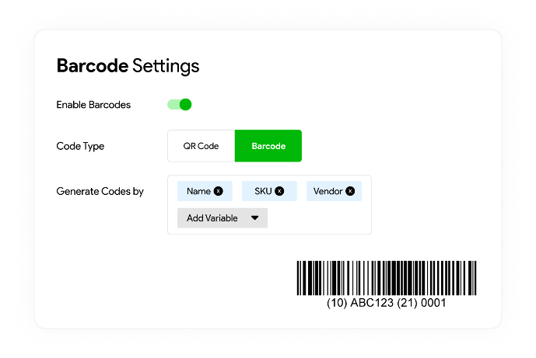
State of the art
Adoption of QR Technology
Popular amongst inventory management systems
Cloud-based data management

Slide 6
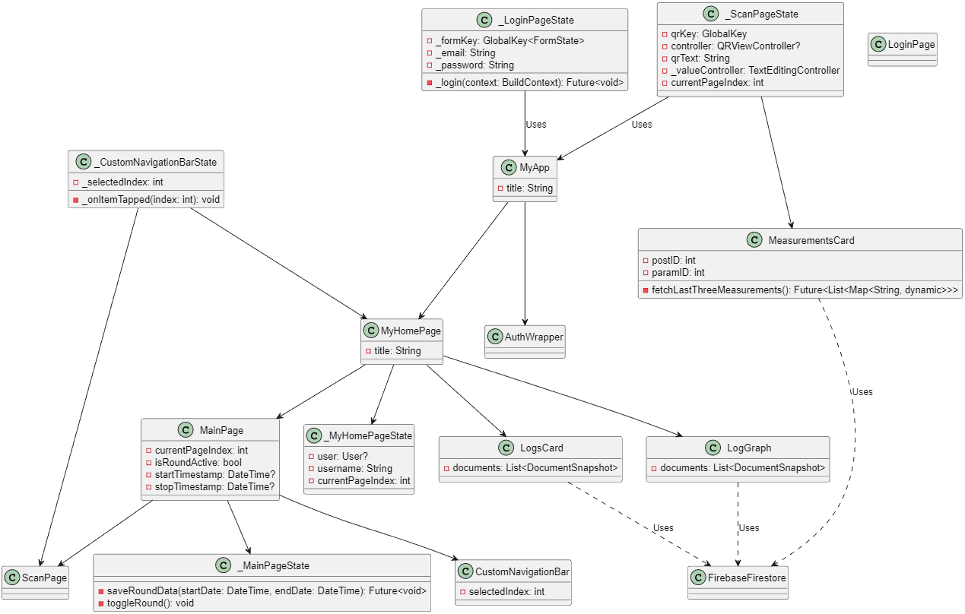
Design Documents

Slide 7
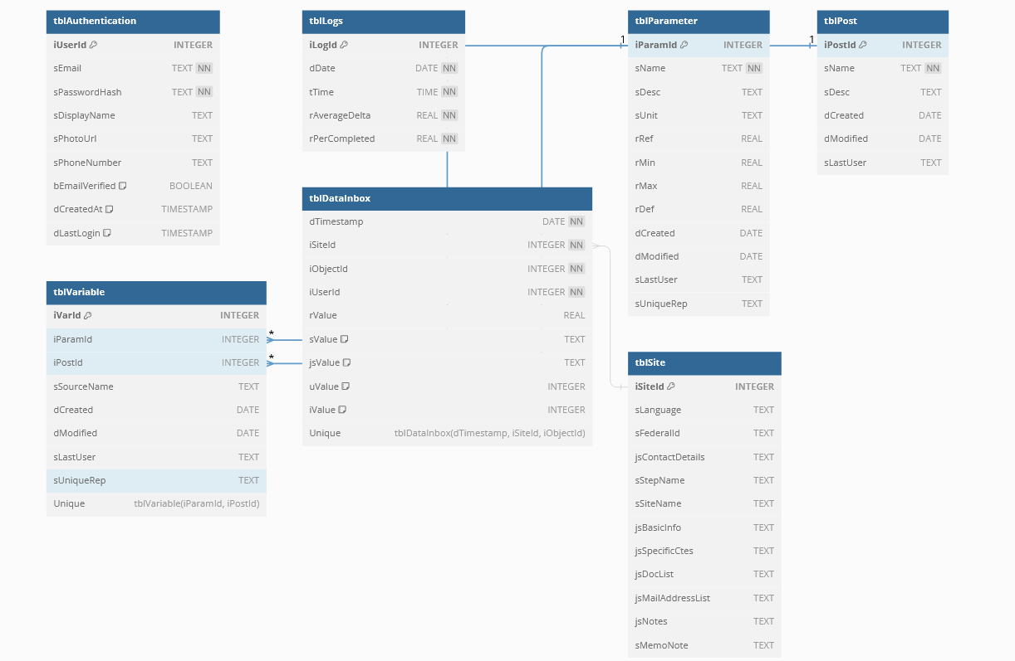
Design Documents

Slide 8
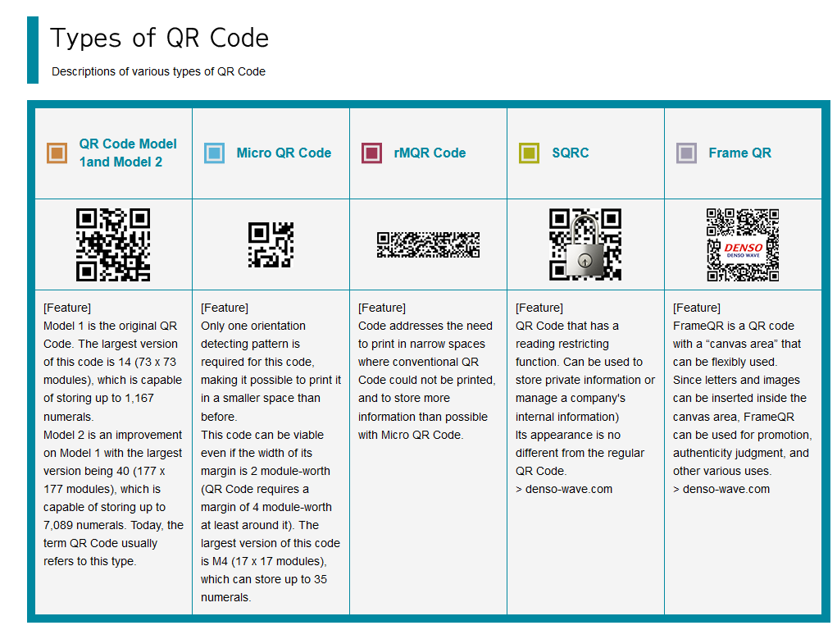
Design Documents
How do QR codes work?
Overview of QR Formats
Model 1 chosen
Simplicity & compatibility

Slide 9

Implementation
Main – MainPage “fragments” dynamic for data persistence
Sub-widgets for card displays
QR functionality using qr_code_scanner
Average measurement statistics & fl_chart display
Data validation – comparison with Firebase data

Slide 10
Conclusion
Main & Secondary objectives met
Solid foundation
Improvements including biometric security, better statistics, etc.
Further testing to be made

Slide 11

Thank you!

Slide 12
Bibliography
IndusTrack inventory management system, https://industrack.com/
Types of QR Codes, QRCode.com, https://www.qrcode.com/en/codes/

